Slide 1
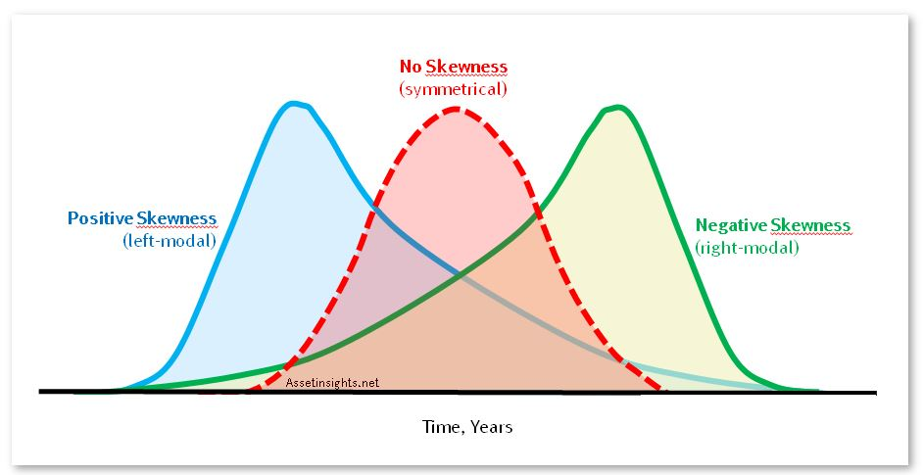
SPY ETF Time Series Analysis
Vinay, Roberto, Jonathan and Brent

Slide 2
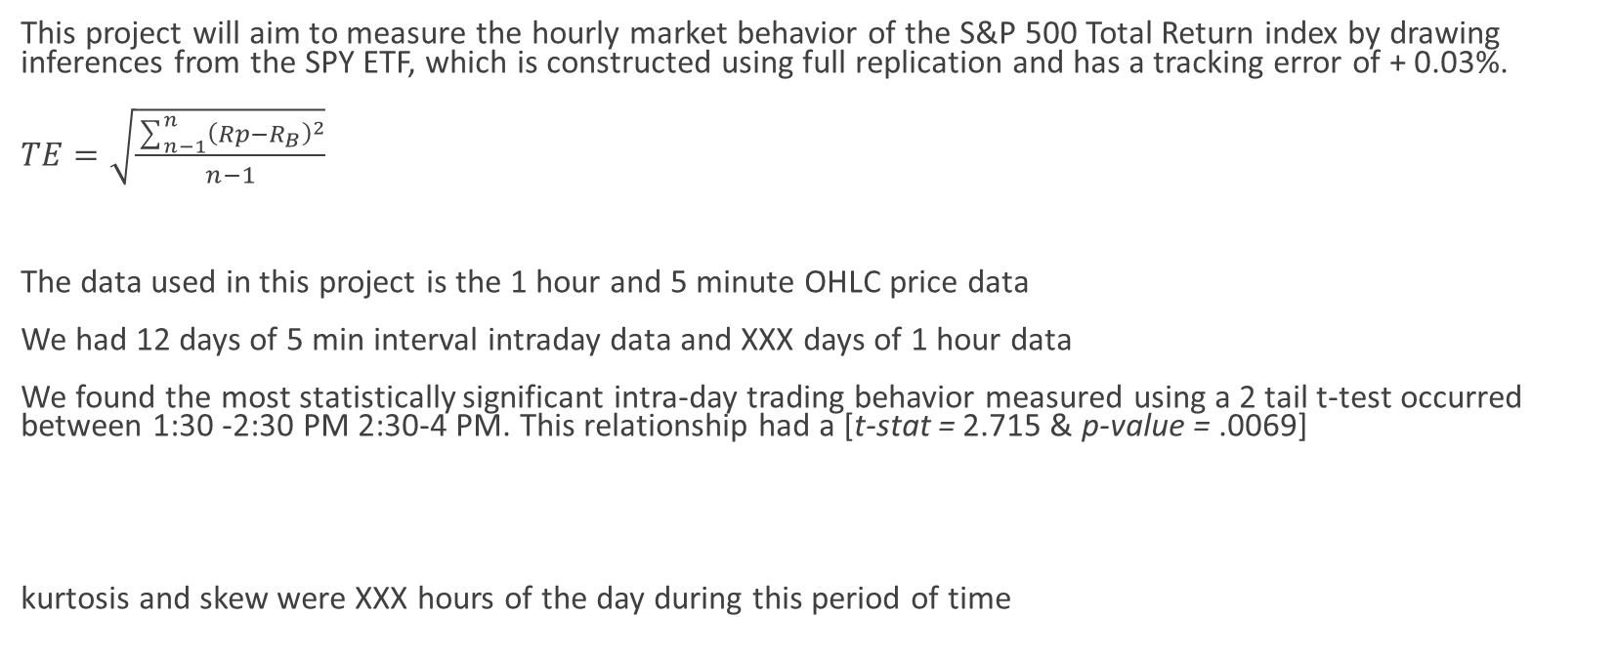
What: Objective and Findings
This project will aim to measure the hourly market behavior of the S&P 500 Total Return index by drawing inferences from the SPY ETF, which is constructed using full replication and has a tracking error of + 0.03%.
$TE=\sqrt{\frac{\sum_{n−1}^{n}{{\left(Rp−R_{B}\right)}^{2}}}{n−1}}$
The data used in this project is the 1 hour and 5 minute OHLC price data
We had 12 days of 5 min interval intraday data and XXX days of 1 hour data
We found the most statistically significant intra-day trading behavior measured using a 2 tail t-test occurred between 1:30 -2:30 PM 2:30-4 PM. This relationship had a [t-stat = 2.715 & p-value = .0069]
kurtosis and skew were XXX hours of the day during this period of time

Slide 3
How
Grouping by each hour for this short time series analysis allowed us to compute the mean and standard deviation. From this we built return distributions of each hour with ~12 daily periods worth of data. We had 12 5M intervals per hour x 6.5 hours per day which gave us a total of 936 data points or roughly 144 data points for each distribution.
Plotting the histograms and overlaying them on each other shows the skewed distributions of returns. We examined these time periods in further detail by conducting t-tests to assess if their underlying statistical properties were different from each other at a significance level of 99%.
-------

Slide 4
Why: The Significance for Systematic Traders
Taking each hour interval and comparing this time period to the other intervals over months would give systematic traders insight into why certain intraday bins were more favorable than others for a given trading strategy.
With this information, investors may want to build time period specific strategies that only trade certain times of the day depending on the market conditions they are looking for.
In theory if there is a time period that offers better risk adjusted returns than others. Investors would identify this set of conditions and based on probabilities would turn on trading algorithms depending on when their systems believed they were entering this more favorable time period.
What needs to be looked at is how we got to the 2:30 window, if we could better predict when the 2:30-4 PM window were to occur on a given day based on past historical data fed into our model. Say 80% or 65% of the days we trade sideways after lunch with no major upcoming domestic of foregin economic news on the calendar and the SPY is above the 200 DMA the market is more likely to exhibit this favorable behavior.
Measure twice, cut once
This Photo by Unknown Author is licensed under CC BY-SA

